Slide 1
Course Project: Religion
By: Shivam Agrawal and Zaid Zia

Slide 2
What I Didn’t Know → Shivam Agrawal
I did not realise that religious diversity and religious discrimination was still such a significant issue.
Anti-semitism is persists in America.
Even though almost two decades have past since 9/11, Sikhs are still being discriminated against and there is still a lot of ignorance with regards to Sikhism.
I did not know that an employer was legally obligated to accommodate for an employee’s religion.
I did not know an employer would be forced to provide kosher or halal meals if asked.
I did not know about the ADL or Tanenbaum and the work that they do to fight religious prejudice and hatred.
I did not know many employees wanted to set aside times during the work day to pray.

Slide 3

What I Didn’t Know → Zaid Zia
Employers around the world discriminate against different religious minorities
Some employers discriminate discriminate unintentionally, being victims of implicit bias
Prayer breaks can increase productivity instead of decreasing it
Companies are required to accommodate for religious practice such as muslims daily prayers, unless it causes the company undue hardship

Slide 4
What Shouldn’t Be Missed
Religious prejudice still runs rampant in the US, and is a problem that needs to be stopped. Especially after 9/11 and other terrorist attacks, eastern religions and cultures are heavily discriminated against in the workplace.
We have rights. Title VII and NJLAD provide a strong legal barrier against religious prejudice in the workplace and it is important to understand them. They ensure that a person’s religion can not be demeaned, and in fact must be accommodated for.
How companies twist the law, and find ways to discriminate against different religions

Slide 5
Social Justice Issues

Slide 6
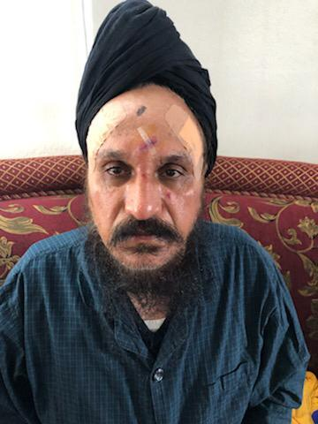
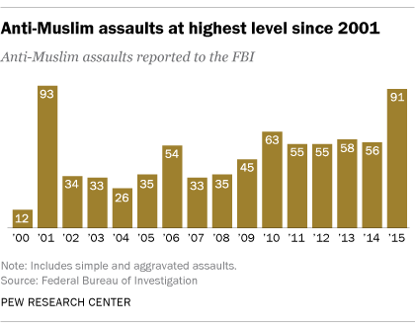
Social Stereotypes
“Muslims are especially vulnerable to stereotypes that so readily pair the word ‘Muslim’ with ‘fundamentalist,’ ‘terrorist’ or ‘holy war’... Muslims are stereotyped as terrorists, fanatics” (“Stereotypes and Prejudice”).
Predominantly after 9/11, Sikhs have been discriminated against for their looks and similarities to the classic image of a terrorist (a brown man with a turban and a long beard)
Anti-semitism still prevails strongly in America, and many negative stereotypes exist:
Jews are disloyal
Jews control the business and financial markets
Jews are responsible for Israel’s actions
Israel is worse than Nazi Germany
“Sikhs are 100 times more likely to be assaulted than the average American citizen because of our distinct appearance” (Kelly).
Notes:
Due to many radical Islamists as well as how Muslims are shown in the media, many people are prone to believing offensive and completely inaccurate stereotypes. Even though Islam is a peaceful religion, they are dehumanized with words such as ‘terrorists’ and ‘fanatics’. It goes so far that the Muslim population must face vandalism, murder, and many more hate crimes. For example, a Muslim woman walked out to her car one morning and saw a swastika painted on it (Stereotypes and Prejudice). I put a chart of anti-Muslim attacks on the slide to show that, while the problem has certainly decreased, assault rates are steadily rising. However, the Muslim population is not the only group scorned because of their connection to radical Islamists. Sikhism and its followers have had to deal with countless acts of discrimination because of their similar appearance to famous terrorists like Osama Bin Laden. More specifically, their turban and the long beard make them targets for stereotypes and a large range of discrimination, from bullying at school to first-degree murder (Green). One example of this is Balbir Singh Sodhi, who wore a turban and was then shot at a gas station for resembling a terrorist (Stereotypes and Prejudice). In the slide, I put a picture of Baljeet Singh Sidhu, who was assaulted in a parking lot in 2019, to show that even almost two decades after 9/11, discrimination is still happening. Lastly, Anti-Semitism, while not overly prevalent in the media, is still running strong in America. A 2020 survey shows that 11 - 14% of Americans (28 million people) have deeply ingrained prejudice against Jewish people. Further, the survey shows that 24% of Americans believe that Jews are disloyal, 27% believe that Jews killed Christ and 30% believe that Jewish employers go out of their way to employ other Jews. Even more concerning, 7% of Americans believed that American Jews are responsible for Israel’s actions, and 14% believe that Israel is worse than Nazi Germany (Anti-Semitic Stereotypes Persist in America). It is quite transparent that there is still quite a bit of religious discrimination against the Jewish population.

Slide 7
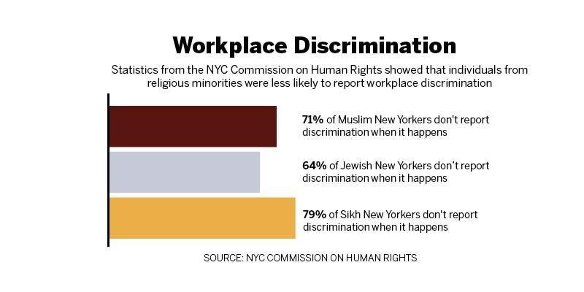
Exclusion, Discrimination, and Inequalities
Muslims have been told to take off their hijab, or they will be fired
Sikhs have been told to take off their turbans or they will be fired
Siks have also been told to shave their beards
EEOC vs Alamo Rent-a-Car LLC
A Muslim employee was fired for wearing a head covering that was violating their ‘Dress-Smart policy’.
Alamo lost the case, for giving undue hardship to an employee
EEOC vs Sambo’s of Georgia, Inc.
A Sikh job applicant was rejected because of the company’s grooming policies, and the applicant did not want to shave for religious reasons
The court ruled in favor of Sambo’s, because an exemption to the grooming policy would ruin Sambo’s clean cut reputation and would give undue hardship
Notes:
There are many challenges faced by the religiously diverse populations in America. I put up a chart on the slide that shows the percentages of people from different religions, 71% for Islam, 79% for Sikhism, and 64% for Judaism, do not report cases. This demonstrates how even though not many cases are seen, the issue is still significant. To be more specific, Muslim women have often been told to take off their hijab, a head covering with great importance in Islam, or they will be fired. For example, a Muslim woman was passed up for a job at Abercrombie and Fitch because she wore her hijab to the interview. She sued, and the Supreme Court ruled 8-1 in her favor (Moodie). Another example is when Alamo Rent-a-Car LLC, a car rental based in Arizona, fired a Muslim employee for wearing her hijab while working at the front desk. Alamo claimed that the hijab was in violation of their dress policy, and, when the employee asked to wear it during the Muslim festival Ramadhan, Alamo said that she could only wear it in the back room. The employee still wore the hijab at the front desk and was then fired. The EEOC took this case on her behalf and won because Alamo was giving her undue hardship (Flake). Next, Sikhs are also commonly discriminated against in the workplace. Most commonly, under threat of termination, Sikhs are asked to remove their turban and shave off their beards. For example, Sambo’s of Georgia Inc., a restaurant, reject a Sikh man’s application to be a restaurant manager, because of their grooming policy. Sambo’s wanted to protect their pristine image and presented multiple facts from surveys about customers having an aversion to dealing with waiters and managers with beards. The court ruled in Sambo’s favor, stating that accepting the Sikh man’s application would cause undue hardship (Flake). Clearly, although the court might rule, either way, discrimination still prevails in the workplace and is a significant factor in office dynamics.

Slide 8
Legal Protections and Allies

Slide 9

Laws and Accepted Policies → Federal Law
What constitutes a religion under federal law?
From the precedents set by Welsh v. United States and United States v. Seeger, the EEOC has defined religion to be a sincerely regarded set of doctrines or principles that dictate what is right or wrong.
Laws against religious discrimination in the workplace
Title VII of the Civil Rights Act of 1964 disallows employers from discrimination of any kind, whether it regards payment, working conditions, or actions that affect an employee’s privileges such as dismissing, demoting, etc., based on an applicant or employee’s religious beliefs. The employer, unless proven unreasonable, must accommodate for all aspects of an employee’s religious belief, including customs and practices. The business must have 15 employees.
What is ‘accommodation’?
A change to a policy or practice that stops a worker from performing their essential duties
What is ‘undue hardship’?
Undue hardship is caused when accommodations take a benefit from another employee promised by a seniority system or a collective bargaining agreement
Notes:
Federal Law Slide
The image is the official seal of the EEOC.
Religion is a set of beliefs that are sincerely held set of principles that dictate what is morally and ethically right and wrong. That is, it is an array of beliefs dictating what actions are to be considered sinful that someone genuinely has faith in.
A vegetarian was fired from her job at the hospital because she refused to take a shot that contained an animal product. She sued and won because she religiously believed in being vegetarian (Gregg).
Title VII
A law that prevents employers from discriminating against anyone due to religion. This includes actions that change an employee’s or job applicant’s status such as hiring, firing, promoting, and many more.
The law also states that an employer must reasonably accommodate an employee’s religion unless it would cause undue hardship on the company.
Accommodation can mean anything from changing company policy to receiving time off for prayer. Most importantly, the accommodation must be a change that affects the essential duties of an employee (Religious Discrimination). For example, swapping a night shift instead of a morning shift for religious reasons is accommodation. Another example would be changing news assignments between reporters due to religious reasons.
Undue hardship is caused when accommodation creates a more than minimal cost to the employer. These costs are not necessarily monetary and can be efficiency, time, safety, and other factors. There are many considerations when discussing undue hardship, such as job responsibilities, office dynamics, operating costs as well as the number of employees that require the accommodation (Question and Answers: Religious Discrimination in the Workplace).

Slide 10

Laws and Accepted Policies → State Law (NJ)
New Jersey Law Against Discrimination (NJLAD)
An employer cannot discriminate against an employee based on their religious faiths, and requires employers to accommodate for it to a reasonable extent. If an employer does not accommodate, they must show how accommodation would cause undue hardship.
How is this different from Title VII?
A business can have any number of employees for NJLAD, but needs 15 for Title ViI
Under Title VII, an employer has to prove that there is or will be undue hardship on the business; NJLAD says that the employer must make an actual effort to accommodate before determining whether there is an undue hardship.
Notes:
State Law Slide
The image on the slide is the official seal of New Jersey.
NJLAD
The New Jersey Law of Discrimination is a state law that prohibits employers from discriminating against employees for job applicants much like Title VII. The beliefs must be sincerely held, in that they are genuinely believed in and followed. These beliefs can not be demeaned nor can an employer try to enforce another religion. It also requires employers to reasonably accommodate all employees’ religions, unless causing undue hardship. (Religion and Creed Discrimination). More specifically, unless an employer can demonstrate that accommodation would be costly, hinder office efficiency and safety, or conflict with a seniority system, the employer must make a real effort to provide accommodation before declaring undue hardship (Reasonable Accommodations for Religious Beliefs).
Difference between Title VII and NJLAD
Title VII only applies to businesses with 15 employees, while NJLAD applies to businesses with 1 employee.
After the 2008 amendment, NJLAD requires an employer to make an effort to accommodate an employee before declaring that it would cause undue hardship. However, it is unclear on what is considered a good enough effort.

Slide 11

Advocacy Groups
Anti Defamation League
A mainly Anti-Semitism focused group that fights against all forms of hate crimes with many different programs to help promote respectful behavior and combat bigotry
A WORKPLACE OF DIFFERENCE
A training program for employees and managers alike to help create an inclusive environment
95% of the program participants left the program with effective skills to thrive in a diverse work environment
Tanenbaum
An organization directed towards removing religious prejudice and combating hatred through education and training programs
Many programs for the workplace:
Employee Luncheons
HR training
Employee Resource Groups
Webinars
Corporate Religious Diversity Assessment: a tool to help companies measure the success of their diversity initiatives as well as identify new goals to strive for.
Notes:
Anti-Defamation League
The picture on the slide is the logo of the ADL.
This is an organization that primarily combats Anti-Semitism on multiple levels and fronts and has been active since 1913. They have now expanded to fighting for several issues including religious freedom, gender equality, LGBT rights, voting rights, racial equality, and many more.
With regards to the workplace, the ADL is committed to helping people understand their rights and what is acceptable in the workplace. They have a short diversity training program called A WORKPLACE OF DIFFERENCE,for both employees and managers, that has shown highly successful results in helping people gain a new perspective on diversity and the skills required to create an inclusive work environment.
To be specific, their findings show that 97% of the participants now understand the need for diversity and 96% found that they are more aware of diversity skills and the role it plays with regards to office interactions (A WORKPLACE OF DIFFERENCE Summary of Findings from Participant Evaluations).
Tannenbaum
This is an organization that is committed to religious freedom as well as fighting religious prejudice. Started in 1992, Tannenbaum has successfully launched programs and initiatives to remove extremism from education, religious bias from the workplace and health care, and bring about an understanding of conflict resolution. They have awarded a select group of people who have risked their lives in the name of their faith in order to bring an end to a conflict with the title ‘Peacemaker’.
With regard to the workplace, Tannenbaum offers many different training programs and consultations in many different forms such as luncheons, resource groups, webinars, and more. They host a broad array of information from religious diversity statistics to facts and essential notes about various religious holidays and events. More specifically, however, their more recent program is their Corporate Religious Diversity Assessment tool. This helps companies test whether or not they are meeting their diversity goals, as well as the best way to move forward and set higher goals.

Slide 12
In Today’s Workplace

Slide 13

What do Employees Desire and Need?
Employees of each religion can have specific needs they desire order to feel welcomed at workplace
For-example muslim employees need accomodations
To wear hijab (Head scarfs)
To set aside time and space for daily prayers
Space To perform ablutions before prayer
To abstain from handling pork in meatpacking plants
To respect gender boundaries
Awareness about muslims alcohol beliefs
Halal dietary options at company’s cafeterias
Hindus, Sikhs and jewish employees would also desire their dietary needs as well as other accommodations to practice their religion during breaks
Notes:
Muslim employees desire accommodations
To wear hijabs (Head coverings)
A lot of Muslim women wear hijab as a tangible representation of their religion representing piety and modesty.
To set aside time or space for daily prayers
Muslims pray five times a day, from which usually two fall within the regular work hours
To perform ablutions before prayer.
Muslims wash their hands, face, and arms before praying
To abstain from handling pork in meatpacking plants
Respect Gender Boundaries
Muslims may have different comfort zones regarding opposite genders. Some might keep their gaze down and refrain from shaking hands.
Their coworkers and managers should know it is not meant to disrespect them
Awareness about Muslims alcohol beliefs
A lot of Muslim employees tend to be excluded from coworkers’ hangouts held at bars. Which might have an impact in them building professional relationships

Slide 14


Opportunities for Equity and Inclusion
Be cautious regarding where to take team members for lunch
Some corporate managers take their team out for lunch once a week or once a month. They should be educated regarding dietary restrictions for their team members whether they eat Halal, Kosher, or Vegetarian food, and go to places in which all of the team members feel comfortable.
Managers should refrain from planning hangouts at bars
Many employees have religious restrictions on Alcohol, so those employees feel “left out” from bar hangouts. Some end up going for the social aspect but feel like the “odd” one left sober
These can exclude employees of specific religious group making them feel left out, odd one out or uncomfortable
Notes:
Management should take specific actions to make sure all of their employees feel respected and comfortable in the workplace. In order to incorporate inclusion in the workplace, it is important to understand what it is. Inclusion refers to letting employees use their voice, participate in the decision-making process, and feel like they belong. It cannot be calculated by numbers; it is rather based on feeling. Some corporate managers take their team out for lunch once a week or once a month. They should be educated regarding dietary restrictions for their team members whether they eat Halal, Kosher, or Vegetarian food, and go to places in which all of the team members feel comfortable. Many employees also have religious restrictions on alcohol, so those employees feel “left out” from bar hangouts. Some end up going for the social aspect but feel like the “odd” one left sober.

Slide 15
Interesting Issue About this Dimension

Slide 16
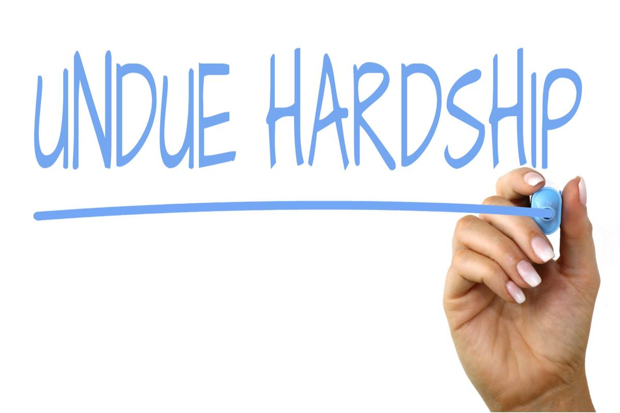
Subtopic: Discrimination Against Islam
Some companies decline to offer accommodations for daily prayers for muslims
Companies argue they cannot allow 2 beaks in between the work day because it would cause a decline in productivity
Even Though the Equal Employment Opportunity Commission (EEOC) requires the companies to accomodate for a religious practice, companies can claim “Undue Hardship” by stating they cause decreasing workplace efficiency
Notes:
Islam is one of the most discriminated religions in the workplace in the United States. Since the 9-11 and other terrorist attacks around the world, Muslims have been victims of enormous prejudice. Some companies decline to offer accommodations for daily prayers for Muslims. Companies state they cannot allow breaks in between the workday because it would cause a decline in productivity. Even Though the Equal Employment Opportunity Commission (EEOC) requires the companies to accommodate religious practice, companies can claim “Undue Hardship” by stating they cause decreasing workplace efficiency (Schouten). What many companies do not realize is that the daily prayer breaks Muslims are requesting are just 5 minutes each, which would just total up to 10 minutes from an 8-hour shift. If timed correctly these breaks can act as refreshers and increase productivity (Malone). Thus, the claim of Undue Hardship that companies are making is either mistaken or misleading.

Slide 17
Thoughts...
Muslims pray five time a day, from which two prayers fall within the regular work hours
The prayer breaks muslims are requesting are just 5 minutes each, totaling up to 10 minutes total from an 8 hour work day.
If timed correctly these breaks are even increase productivity instead of decreasing it ( Malone)
Companies claiming undue hardship due to muslims is an act of active discrimination with no truth behind it
This is the team opinion

Slide 18
Bibliography

Slide 19
06.13.18, Robert E. Gregg. “Religion in the Workplace.” Boardman Clark, 24 June 2020, www.boardmanclark.com/publications/the-reading-room/religion-in-the-workplace.
Anti-Defamation League, www.adl.org/.
“Anti-Semitic Stereotypes Persist in America, Survey Shows.” Anti-Defamation League, www.adl.org/news/press-releases/anti-semitic-stereotypes-persist-in-america-survey-shows.
“Are Employers Required to Grant Prayer Breaks to Muslim Employees?” The Christian Science Monitor, The Christian Science Monitor, 25 May 2016, www.csmonitor.com/USA/Society/2016/0525/Are-employers-required-to-grant-prayer-breaks-to-Muslim-employees.
Bastian, Rebekah. “Five Tips For Supporting Muslims In The Workplace.” Forbes, Forbes Magazine, 17 July 2019, www.forbes.com/sites/rebekahbastian/2019/07/17/five-tips-for-supporting-muslims-in-the-workplace/#42ff9db037d1.
“EEOC Coronavirus Resources.” Home | U.S. Equal Employment Opportunity Commission, 22 June 2020, www.eeoc.gov/.
Flake, Dallan, Image is Everything: Corporate Branding and Religious Accommodation in the Workplace (February 15, 2014). University of Pennsylvania Law Review, Vol. 163, 2014-15.
Green, Emma. “The Trouble With Wearing Turbans in America.” The Atlantic, Atlantic Media Company, 27 Jan. 2015, www.theatlantic.com/politics/archive/2015/01/the-trouble-with-wearing-turbans-in-america/384832/.
Islinger Berkeley Heights 908-795-5203, David G. “Change to New Jersey Law Against Discrimination Provides Employees Greater Religious Accommodation Rights.” Jackson Lewis, 1 June 2015, www.jacksonlewis.com/resources-publication/change-new-jersey-law-against-discrimination-provides-employees-greater-religious-accommodation-rights.
Kelly, George. “Richmond Police Investigate Weekend Attack on Sikh Man.” East Bay Times, East Bay Times, 18 Dec. 2019, www.eastbaytimes.com/2019/12/17/richmond-police-investigate-weekend-attack-on-sikh-man/.
Kishi, Katayoun. “Anti-Muslim Assaults Reach 9/11-Era Levels, FBI Data Show.” Pew Research Center, Pew Research Center, 21 Nov. 2016, www.pewresearch.org/fact-tank/2016/11/21/anti-muslim-assaults-reach-911-era-levels-fbi-data-show/.
Malone, Matt. “Let Us Pray: the Challenges of Accommodating Muslim Prayer in the Workplace.” Lexology, 28 July 2017, www.lexology.com/library/detail.aspx?g=e3a833eb-73d6-4dfe-ac7e-bd42284715f8.
Mgryczon. “Official Site of The State of New Jersey.” The Official Web Site for The State of New Jersey, nj.gov/.
Moodie, Alison. “Are US Businesses Doing Enough to Support Religious Diversity in the Workplace?” The Guardian, Guardian News and Media, 28 Jan. 2016, www.theguardian.com/sustainable-business/2016/jan/28/religious-diversity-us-business-muslim-hijab-discrimination-equal-employment-eeoc.
“New Jersey Religious Discrimination: Workplace Discrimination.” Costello & Mains, LLC, www.costellomains.com/Employment-Law/Employment-Discrimination/Religion-Creed-Discrimination.shtml.
Paradiso, Anthony. “The Importance of Inclusion in the Workplace.” Engage Blog, www.achievers.com/blog/the-importance-of-inclusion-in-the-workplace/#:~:text=Diversity%20does%20not%20exist%20without,positively%20engaged%20within%20the%20organization.
“Questions and Answers: Religious Discrimination in the Workplace.” Questions and Answers: Religious Discrimination in the Workplace | U.S. Equal Employment Opportunity Commission, www.eeoc.gov/laws/guidance/questions-and-answers-religious-discrimination-workplace.
“Reasonable Accommodations for Religious Beliefs.” New Jersey Employment Lawyers, www.njemploymentlawfirm.com/reasonable-accommodations-for-religious-beliefs.html.
“Religious Discrimination and Accommodation in the Federal Workplace.” U.S. Department of Labor Seal, www.dol.gov/agencies/oasam/civil-rights-center/internal/policies/religious-discrimination-accommodation.
“Religious Discrimination.” U.S. Equal Employment Opportunity Commission, www.eeoc.gov/religious-discrimination.
“Stereotypes and Prejudice.” The Pluralism Project, pluralism.org/stereotypes-and-prejudice.
“Top Lawyers, Top Attorneys, Top Law Firms.” Primerus, www.primerus.com/business-law-articles/accommodating-islam-in-the-workplace-a-work-in-progress-332011.htm.
“A WORKPLACE OF DIFFERENCE®.” Anti-Defamation League, 6 Sept. 2012, www.adl.org/news/article/a-workplace-of-differencer.
“Workplace.” Tanenbaum.org, tanenbaum.org/programs/workplace/.
Zelada, Brittany. “New Religious Garb Bill Will Expand Religious Rights in the Workplace.” The Daily Orange, 29 Apr. 2019, dailyorange.com/2019/04/new-religious-garb-bill-will-expand-religious-rights-workplace/.

Slide 20
Discussion Points

Slide 21
Questions
What would you consider a ‘good enough’ effort from the employer when making accommodations for an employee?
Many organizations create diversity training programs to combat religious discrimination in the workplace. What are some other ways of eliminating religious discrimination in the workplace?
Do you think that Title VII and the NJLAD are too restrictive, or not restrictive enough? Why? What are some changes you would make to current legislation regarding religious discrimination?
Have you experienced any hardship at workplace because of your religion?

